Slide 1



Duration: 60 min
University
Undergraduate
IoT
Publish Sensor Readings to ThingSpeak with ESP32
Workshop: Internet of Things

Slide 2
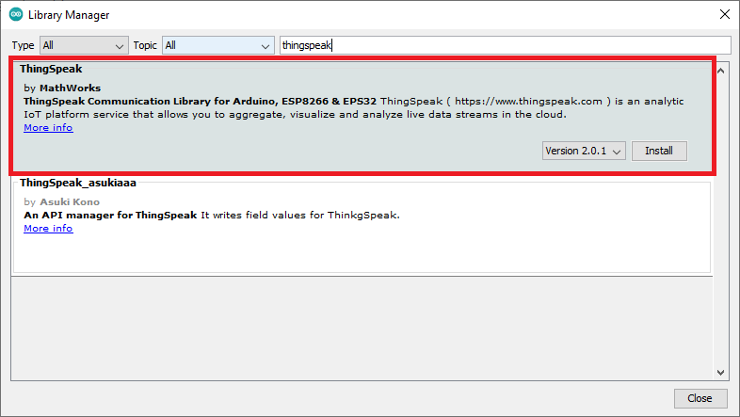
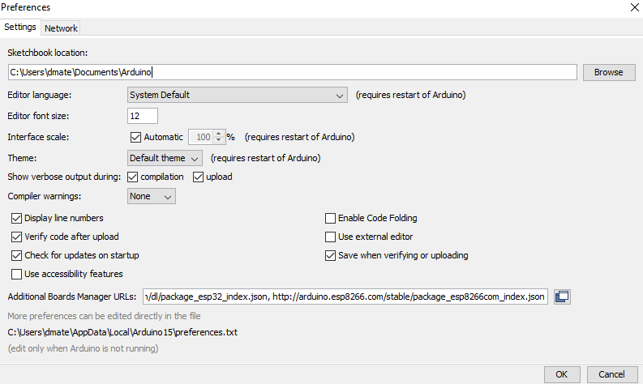

Lesson overview
In this guide, you’ll learn how to send sensor readings with the ESP32 to ThingSpeak. For demonstration purposes, we’ll use a potenciometer, but you can easily modify the examples to use any sensor. The ESP32 board will be programmed using the Arduino core.
Learning objectives
Keywords
Learn about IoT platforms
Understand the ESP32 software and hardware management
Use of basic publication functions in thingspeak
IoT, ThingSpeak, ESP32, ArduinoIDE
Learning objectives
Prerequisites
Installing Arduino IDE: Software | Arduino
Installing the ESP32 Board in Arduino IDE: Installing ESP32 in Arduino IDE
Installing ThingSpeak Arduino Library: ThingSpeak Communication Library for Arduino
Installing other libraries: GitHub
Create a MathWorks account: Sign In - ThingSpeak IoT

Slide 3
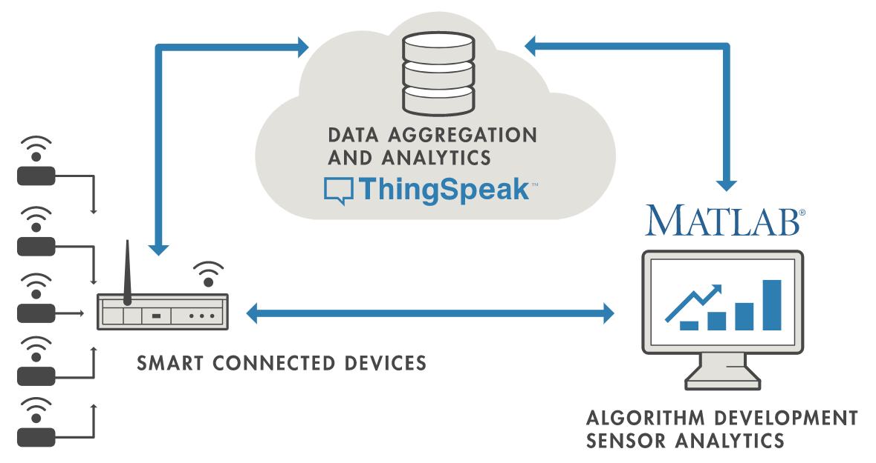
1. Introduction
5
min
ThingSpeak™ is an IoT analytics platform service that allows you to aggregate, visualize and analyze live data streams in the cloud. ThingSpeak provides instant visualizations of data posted by your devices to ThingSpeak. With the ability to execute MATLAB® code in ThingSpeak you can perform online analysis and processing of the data as it comes in. ThingSpeak is often used for prototyping and proof of concept IoT systems that require analytics.

Slide 4
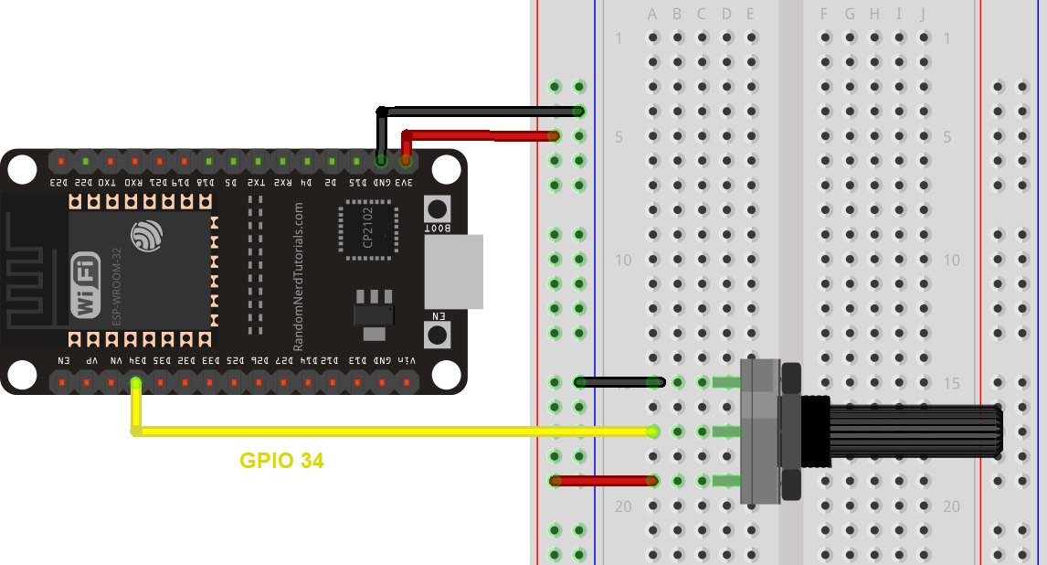
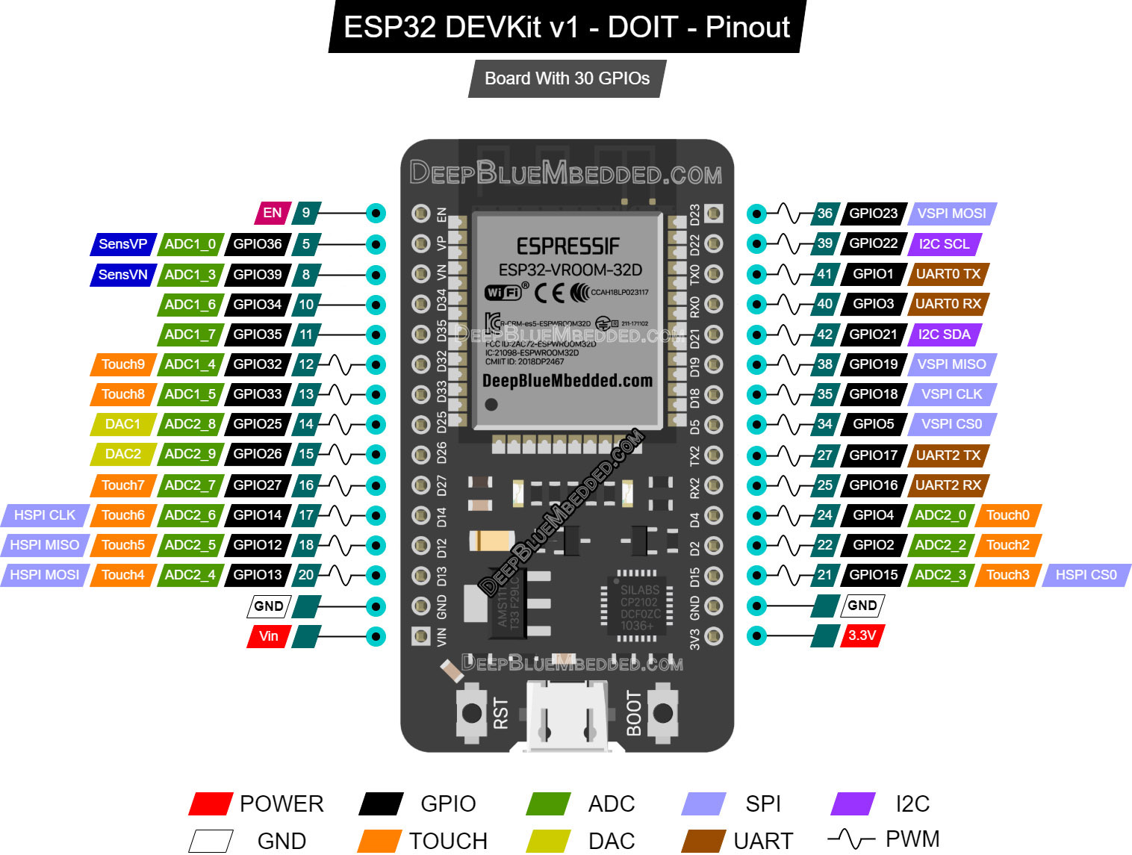
2. Schematic Diagram
5
min
We’re going to use an ADC I/O port (GPIO 34) and sources pins (3v3 and GND)
Recommended reading: ESP32 Pinout Reference: Which GPIO pins should you use?

Slide 5
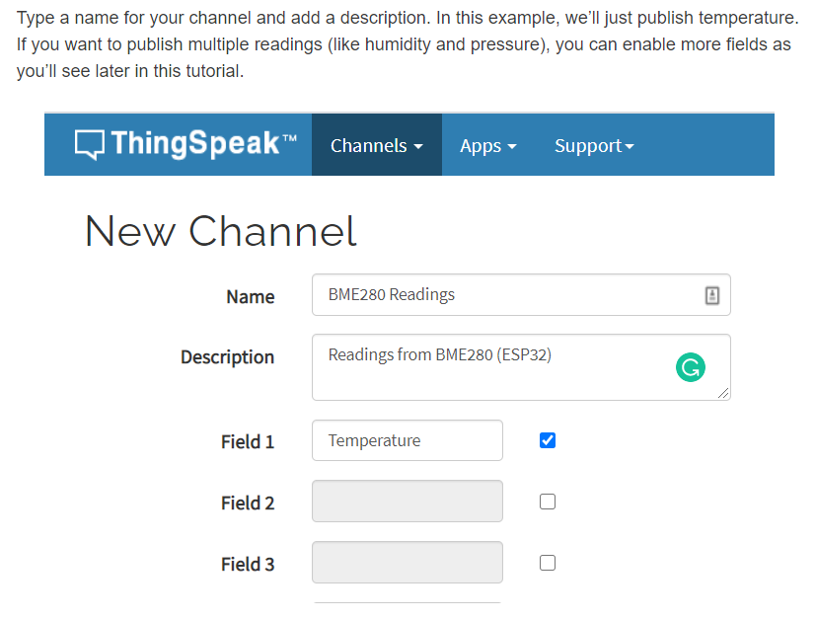
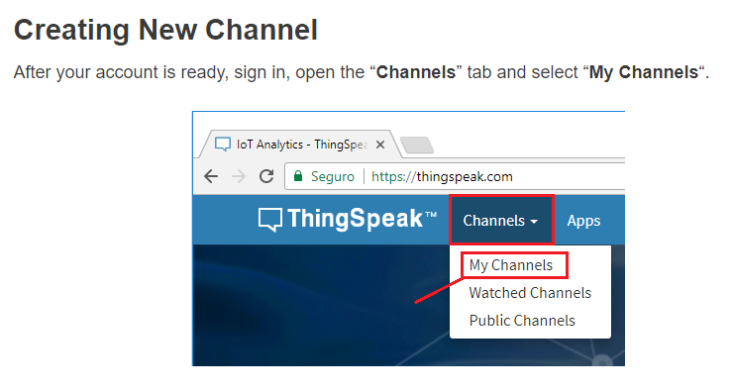
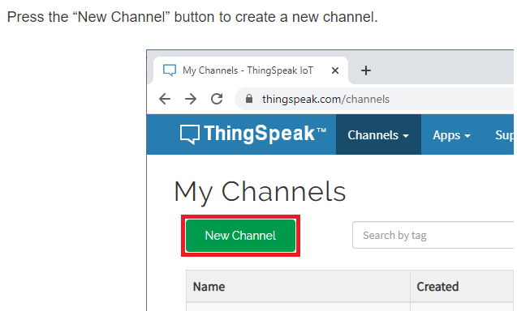


3. ThingSpeak – Getting Started
10
min

Slide 6
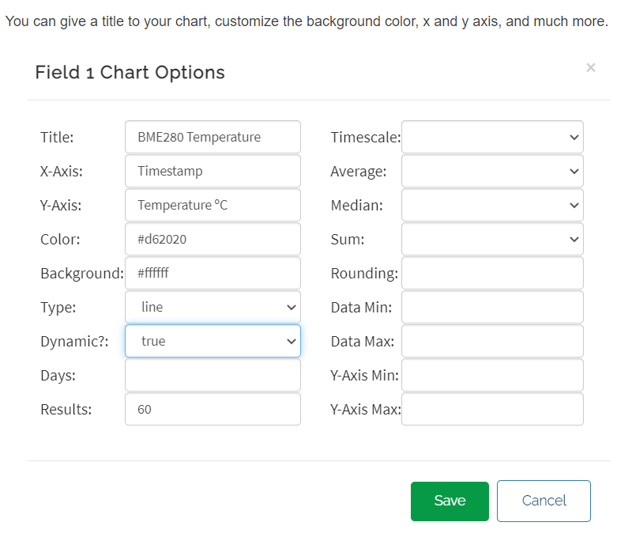
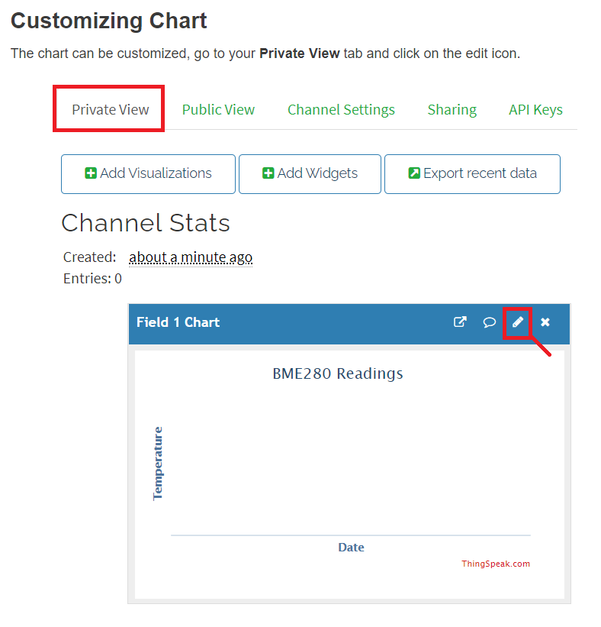
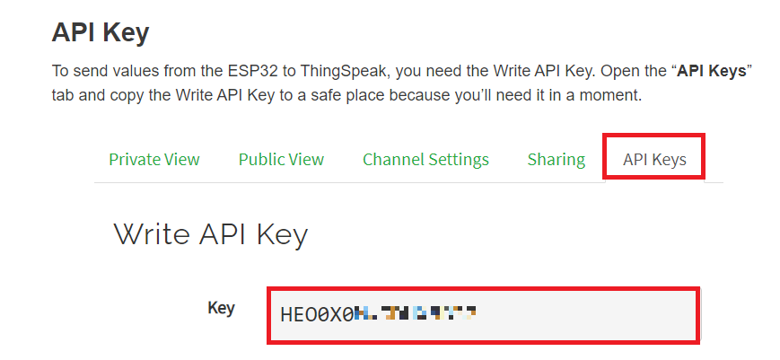
3. ThingSpeak – Getting Started
10
min

Slide 7
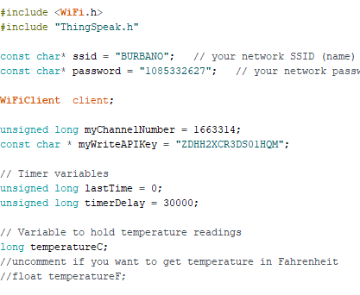
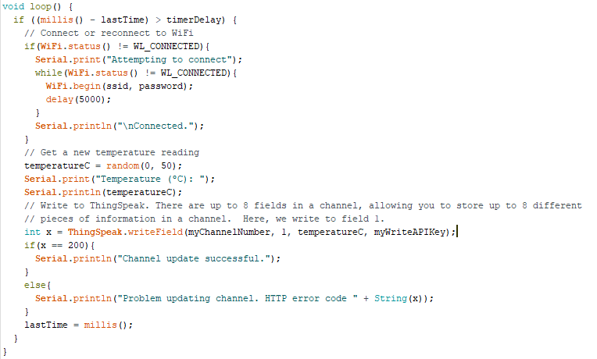
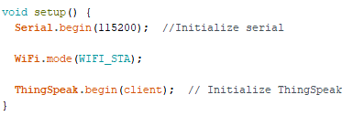
4. ESP32 Code
5
min
HEADERS AND CONFIGURATION
MAIN CODE
INITIALIZATION

Slide 8
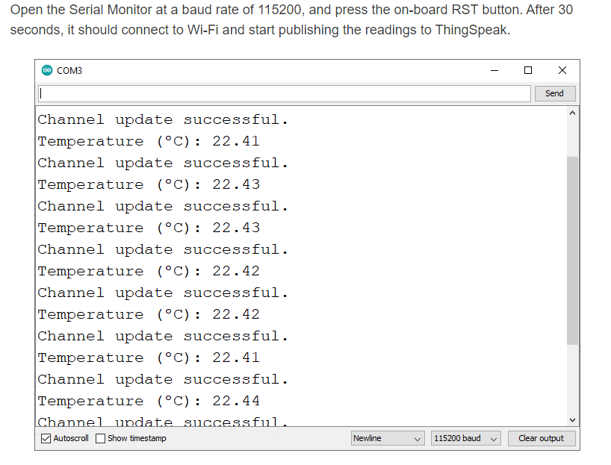
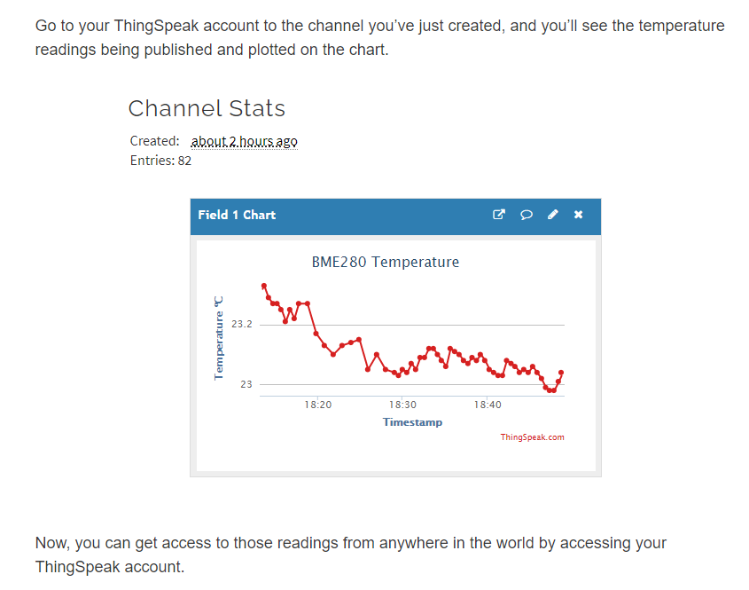
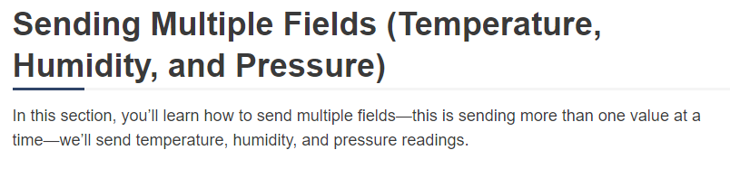
5. Demostration & More
10
min

Slide 9


Thanks
E-mail: danielmburbano@umariana.edu.co

